Slide 1
“Involving children in deciding what gets measured and how.
A child rights-based approach”
Professor Laura Lundy
Centre for Children’s Rights
Queen’s University, Belfast

Slide 2
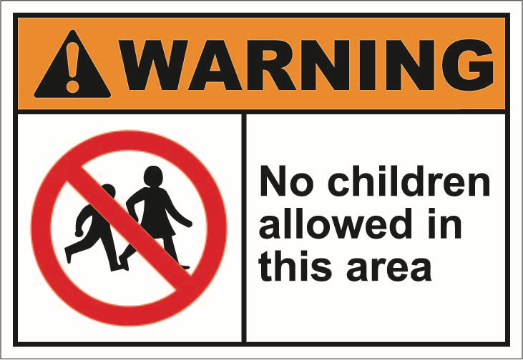
Seeking children’s perspectives on what matters to them

Slide 3
Degrees of involvement
Parents are asked about children’s experiences: proxies
Children are asked about their own experiences: passers-by
Children are asked about their lives and this is used by researchers to inform what children should be asked: pilots
Children are given time to think about the issues and are involved in deciding what needs to be measured and how partners

Slide 4
What is a
‘Children’s Rights Based Approach?’
  The activity should:
  Further the realisation of children’s human rights.
  Human rights standards should guide the process ( e.g. Include children in ways that are meaningful, safe and inclusive) (Arts. 12, 19, 2 of the UNCRC)
  Contribute to the development of the capacities of the duty-bearers to meet their obligations and of the rights-holders to claim their rights
Adapted by Lundy & McEvoy (2012) from the Statement of Common Understanding of Human Rights Based Approaches (UN, 2003)

Slide 5
Two core features of our approach

Slide 6
Working with children as advisors throughout the process
Young People’s Advisory Groups
Children’s Advisory groups

Slide 7
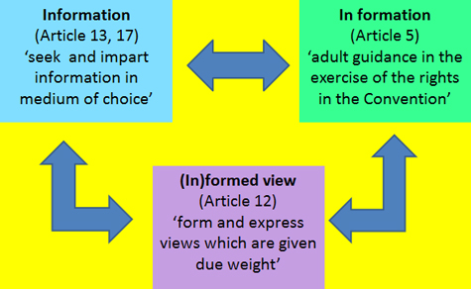
Building children’s capacity to understand the issues

Slide 8
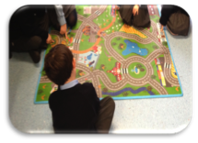

Example 1: General Comment No.19 on Public Budgeting (2016)
  ‘the right to information is essential, because it is the precondition of the child’s clarified decisions’
  (UN, 2009)

Slide 9
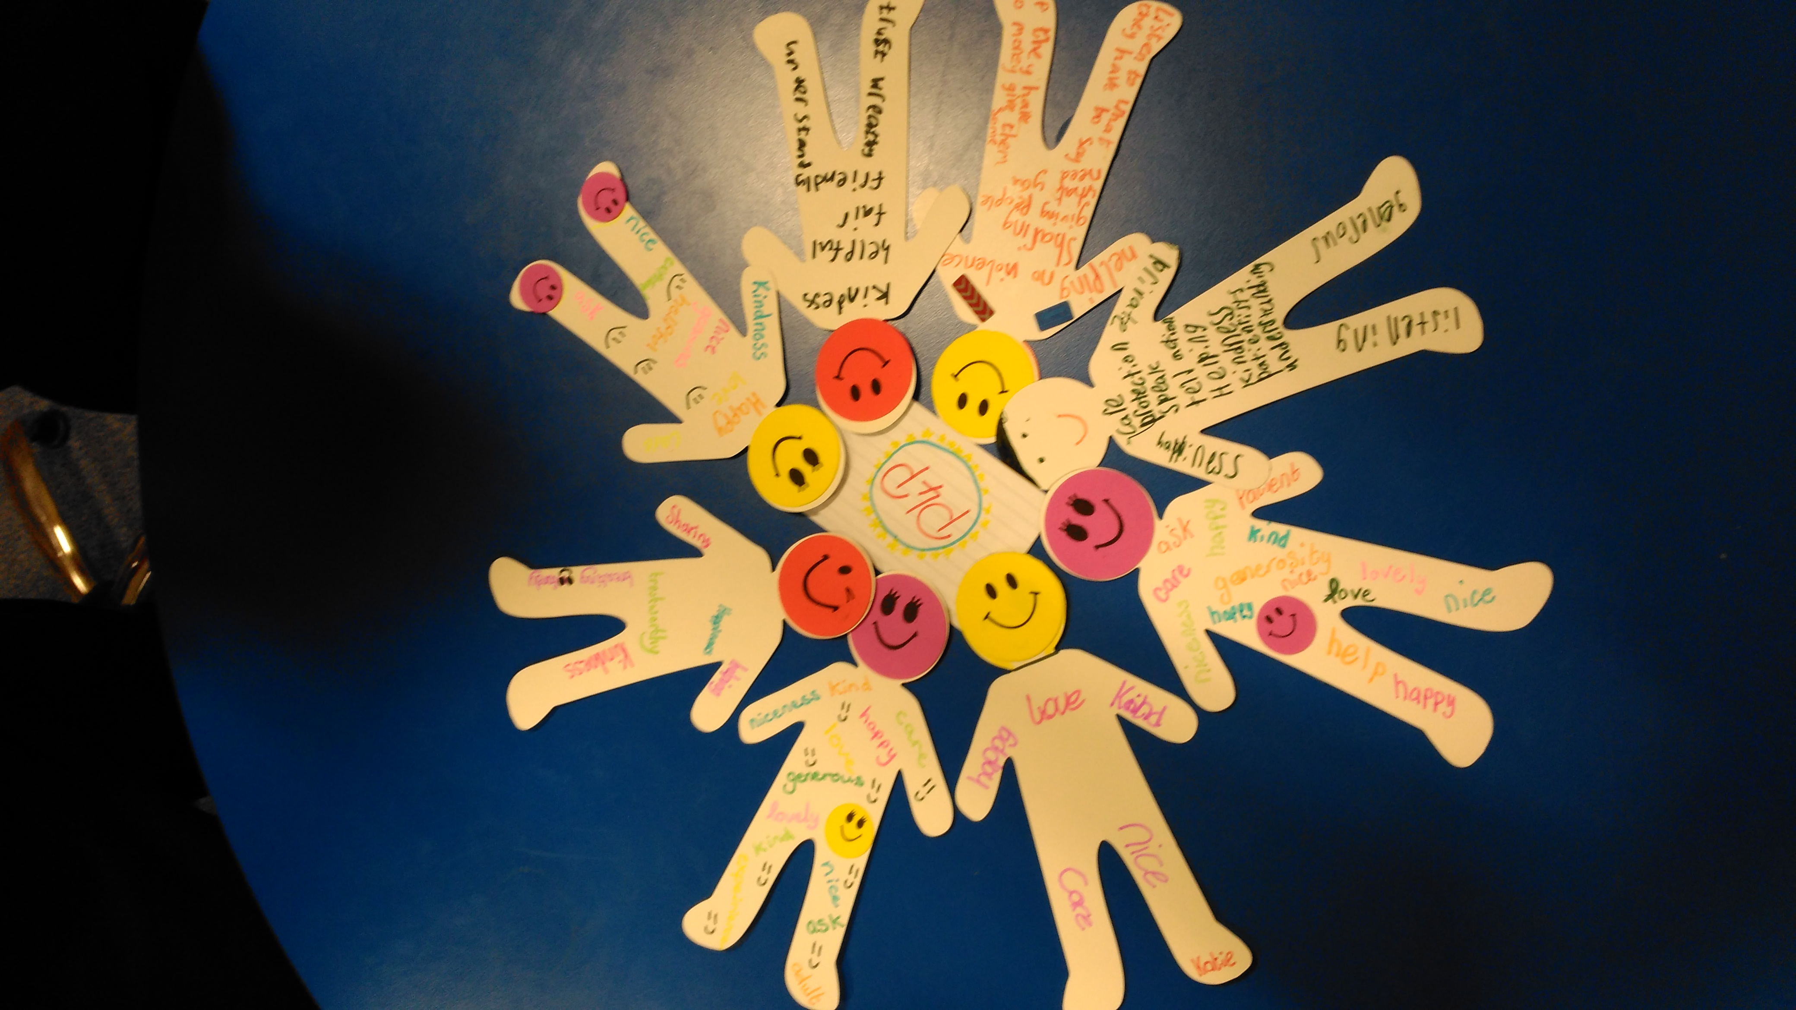

Violence – ‘what matters to me’
Adults should be absorbing of what children tell them - Tara aged 9

Slide 10
Involving children in deciding what gets measured

Slide 11

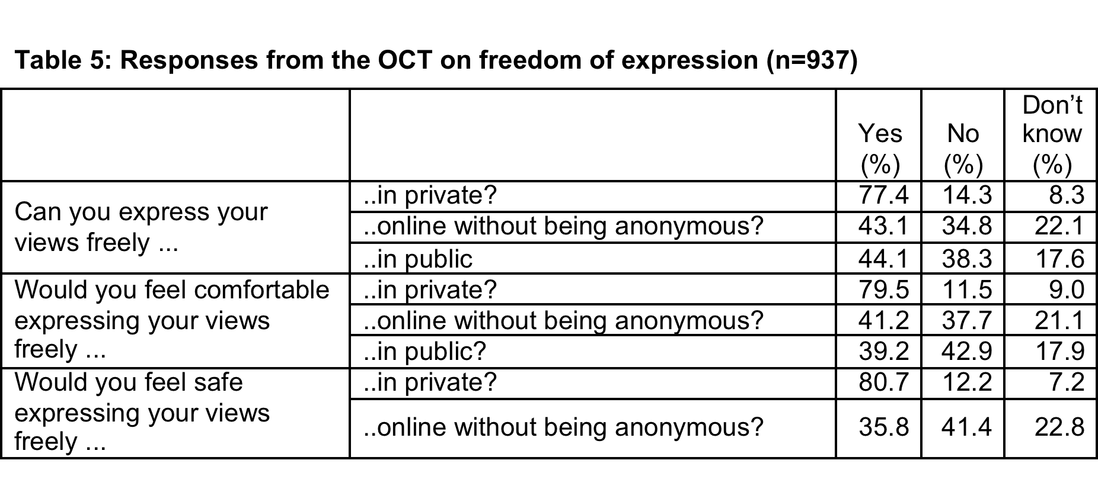
Example 1: Children’s enjoyment of their civil and political rights

Slide 12


Example 2: rights in the digital environment for children with disabilities.
Participation
Protection
Provision

Slide 13
Involving children in deciding how it gets asked
…
(when they are reporting on their own lives)

Slide 14
‘’the language dilemma is mutual”
Punch (2002)

Slide 15
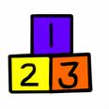
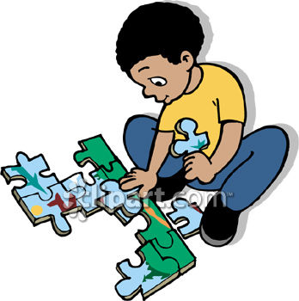
Example 1: can’t always use words

Slide 16
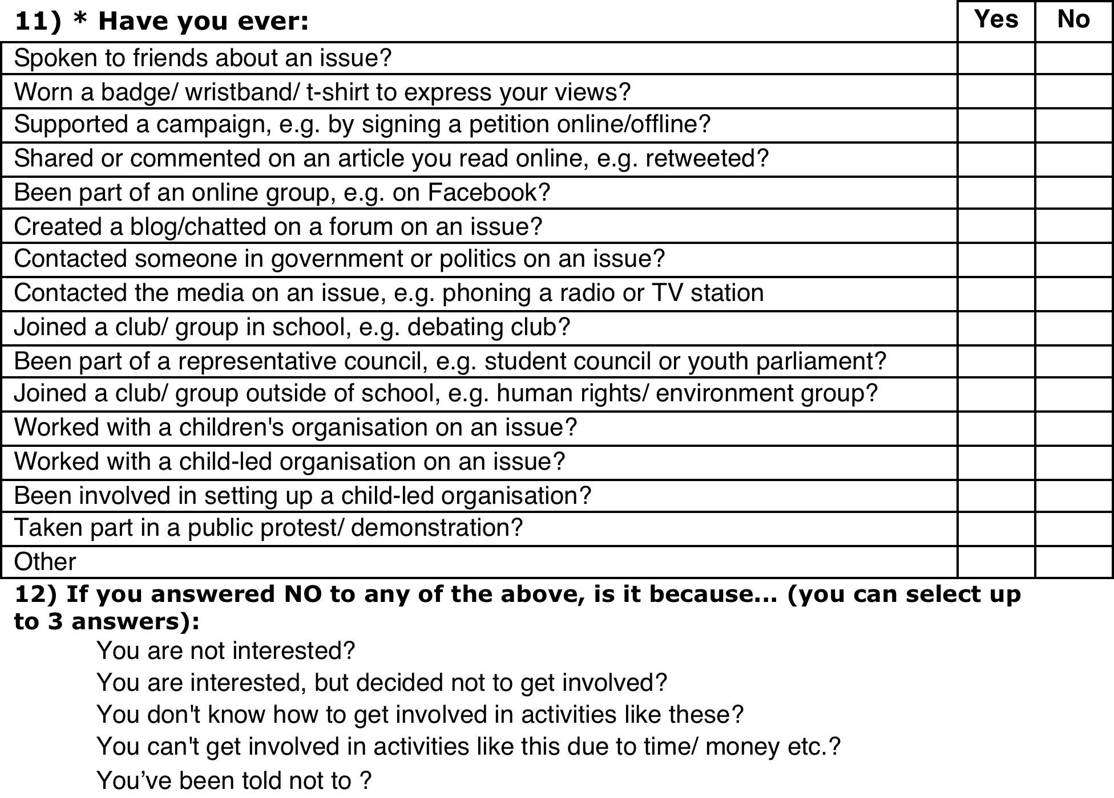
Example 2: helping children to form a view

Slide 17
Why involve children?
Hard to defend measuring the effectiveness of children’s rights in a process that excludes them (and is therefore in breach of Art. 12)
Measuring what matters.
Measuring with greater accuracy.
And, importantly, the process can be important as the product - building children’ s capacity to understand and claim their rights

Slide 18
References
Lundy, L. & McEvoy, L. (2012) What constitutes a children’s rights-based approach to research? In M. Freeman (ed) Law and Childhood, London, Brill.
Lundy, L. & McEvoy, L. (2012) Children’s Rights-Based Research Methods: Assisting Children to (In)Formed Views, Childhood

